Slide 1



welcome to the world of data science
Presented by: [KULDEEP SINGH YADAV]
Organization : [Next hike IT solution]
PROJECT NO : 4TH

Slide 2
Feature Extraction and Price Prediction for Mobile Phones
This presentation outlines a project to develop a predictive model for mobile phone prices, using feature extraction to identify the most influential features.
By : Kuldeep Singh Yadav

Slide 3
Project Overview
Objective
Dataset
Build a predictive model to estimate mobile phone prices based on the features.
Detailed information on various mobile phones, including model, color, memory, RAM, battery capacity, camera specifications, processor, and price.

Slide 4

Data Exploration and Preprocessing
1
Loading and Understanding the Data
2
Handling Missing Values and Outliers
Address missing values, outliers, and inconsistencies in the data.
Analyze the dataset's structure, data types, and value ranges for each feature.
3
Data Transformation
Convert categorical variables into a numerical format using techniques like one-hot encoding.

Slide 5
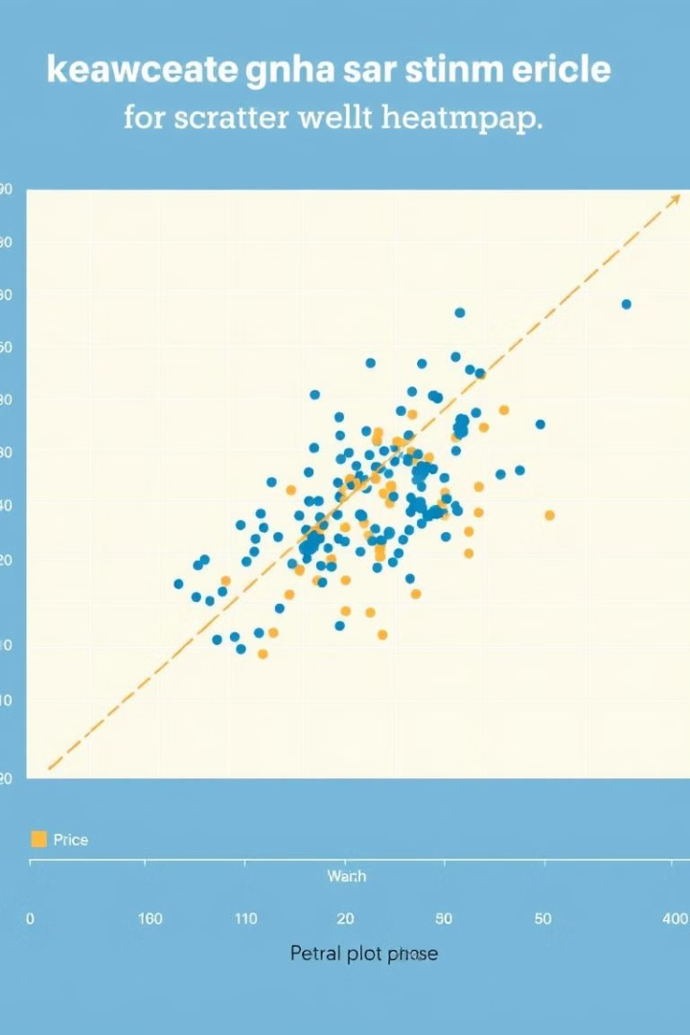
Feature Extraction
Identifying Key Features
Correlation Analysis
Analyze the relationships between features and price to identify potential predictors.
Use statistical methods, visualizations, or feature importance techniques to identify features that strongly affect price.
Feature Selection
Select the most relevant features using techniques like feature selection or dimensionality reduction.

Slide 6
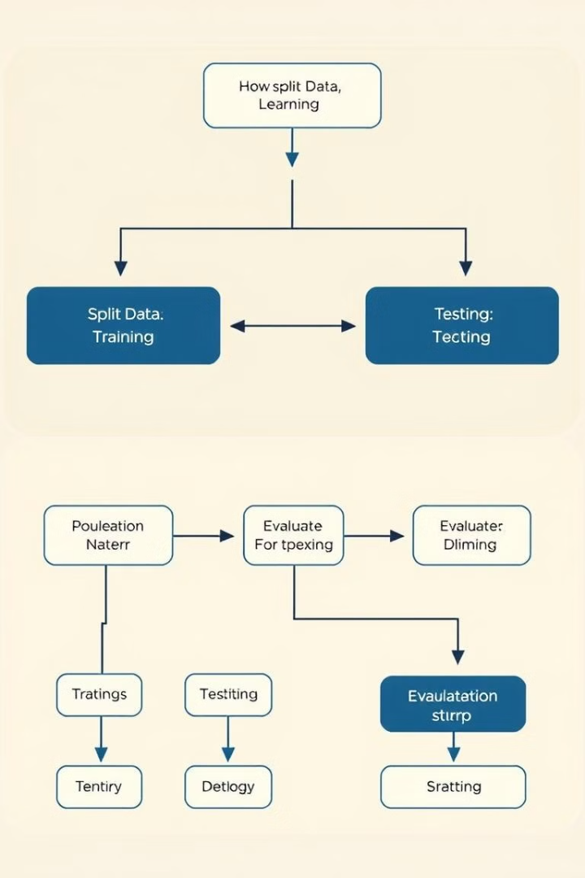



Model Building and Evaluation
Data Splitting
Model Selection
Model Evaluation
Divide the dataset into training and testing sets for model development and evaluation.
Choose an appropriate machine learning algorithm for price prediction, such as linear regression, decision trees, or more advanced models.
Evaluate the model's performance using metrics like mean absolute error and root mean squared error.

Slide 7
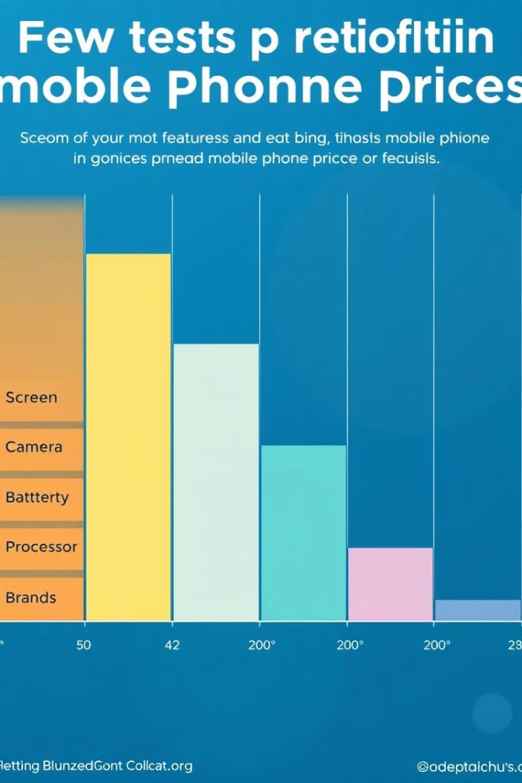
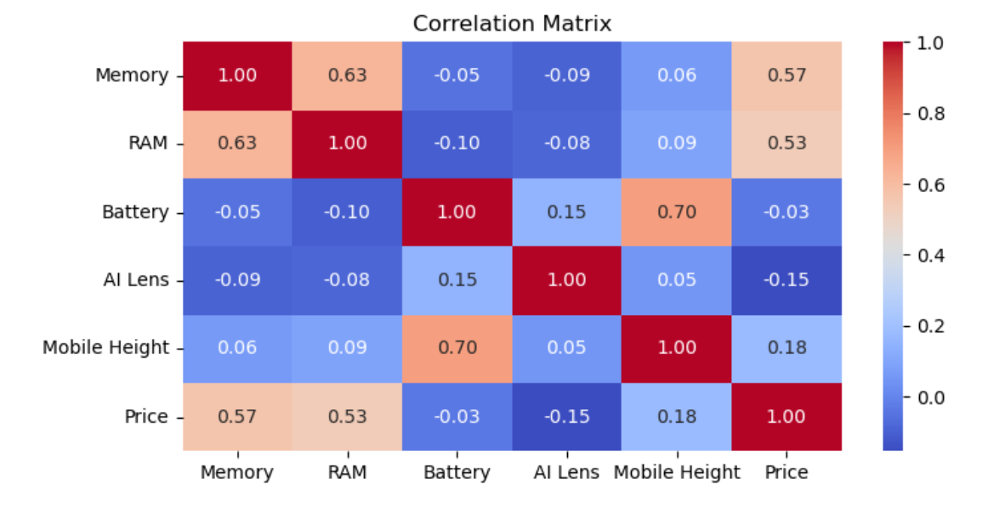
Feature Importance Analysis
1
Confirming Feature Significance
Analyze the feature importances obtained from the model to validate the relevance of features identified during extraction.
2
Insights and Interpretation
Interpret the feature importance scores to understand which features have the most significant impact on price.

Slide 8


Report and Visualization
Project Summary
Create a comprehensive report or presentation that summarizes the project's findings.
Visualizations
Include visualizations and insights related to feature importance and their impact on price prediction.

Slide 9


Recommendations
Pricing Strategies
Marketing Decisions
Provide recommendations to the organization regarding which features have the most significant influence on mobile phone prices.
1
Inform pricing strategies and marketing decisions based on the project's findings.
2

Slide 10
Deliverables and Next Steps
Project Report/Presentation
1
A detailed report or presentation outlining the entire project process, from data exploration to model building and evaluation.
Code and Scripts
2
All code and scripts used in the project, including data preprocessing, feature extraction, model building, and evaluation.
Visualizations and Insights
3
Visualizations and insights related to feature importance and their impact on price prediction.
Recommendations
4
Recommendations for the organization based on the project's findings, informing pricing strategies and marketing decisions.

Slide 11
C o n c l u s i o n s !
In this project, we leveraged data science techniques to analyze and extract meaningful insights from the given dataset. Our findings highlight key trends
and patterns that can aid in better decision-making and optimization in linear rg. By applying machine learning models and statistical analysis, we achieved [mention key results, e.g., high accuracy, improved predictions].
Despite certain challenges, such as data limitations and model constraints, this study demonstrates the potential of data science in solving real-world problems.
Future work could focus on refining models, incorporating more diverse datasets, and implementing real-time analytics for enhanced performance.
Data science continues to evolve, opening new opportunities for innovation and informed decision-making across various industries. We successfully
developed and evaluated a Machine learning model via linear regression for EDA Mobile data project.
The model achieved feature engennring such as a univarient , multiverient & correlation e.g., accuracy, precision, mean squre , RMSE
Key factors influencing the results including data cleaning, scaling , visualtation thorugh graph and try to find out the outlier from box plot and try to

Slide 12

T H A N K Y O U !
Do you have any question ?

